Slide 1
Campbell HS Bands
Band Booster Meeting
Thursday, April 11, 2024
7 pm

Slide 2
!

Slide 3
Campbell Band Boosters Association (CBBA)
Board of Directors
Tony Annacchino: President
Jennifer Annacchino: Vice President
Sommerset Naser & Katrina Addison: Treasurers
Audrey Young: Secretary
Keerty Das & Annie Denoziere: Concert Band At-Large
Farrah Galloway: Marching Band At-Large

Slide 4
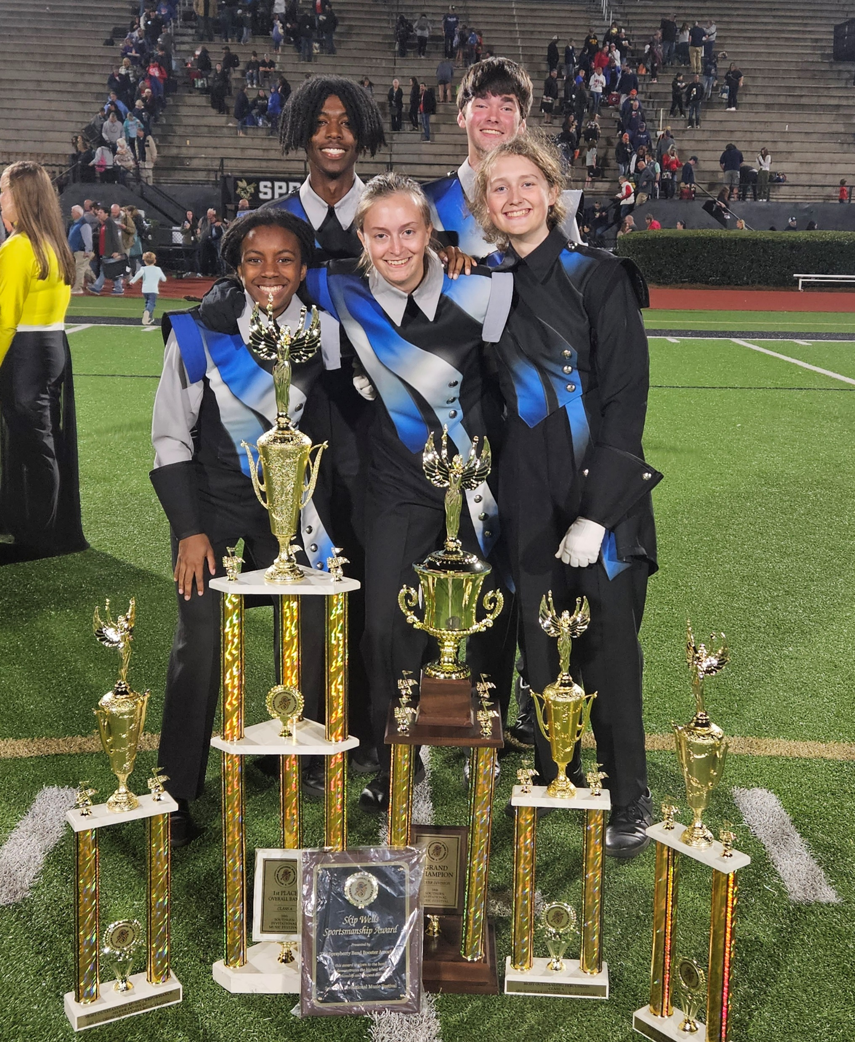
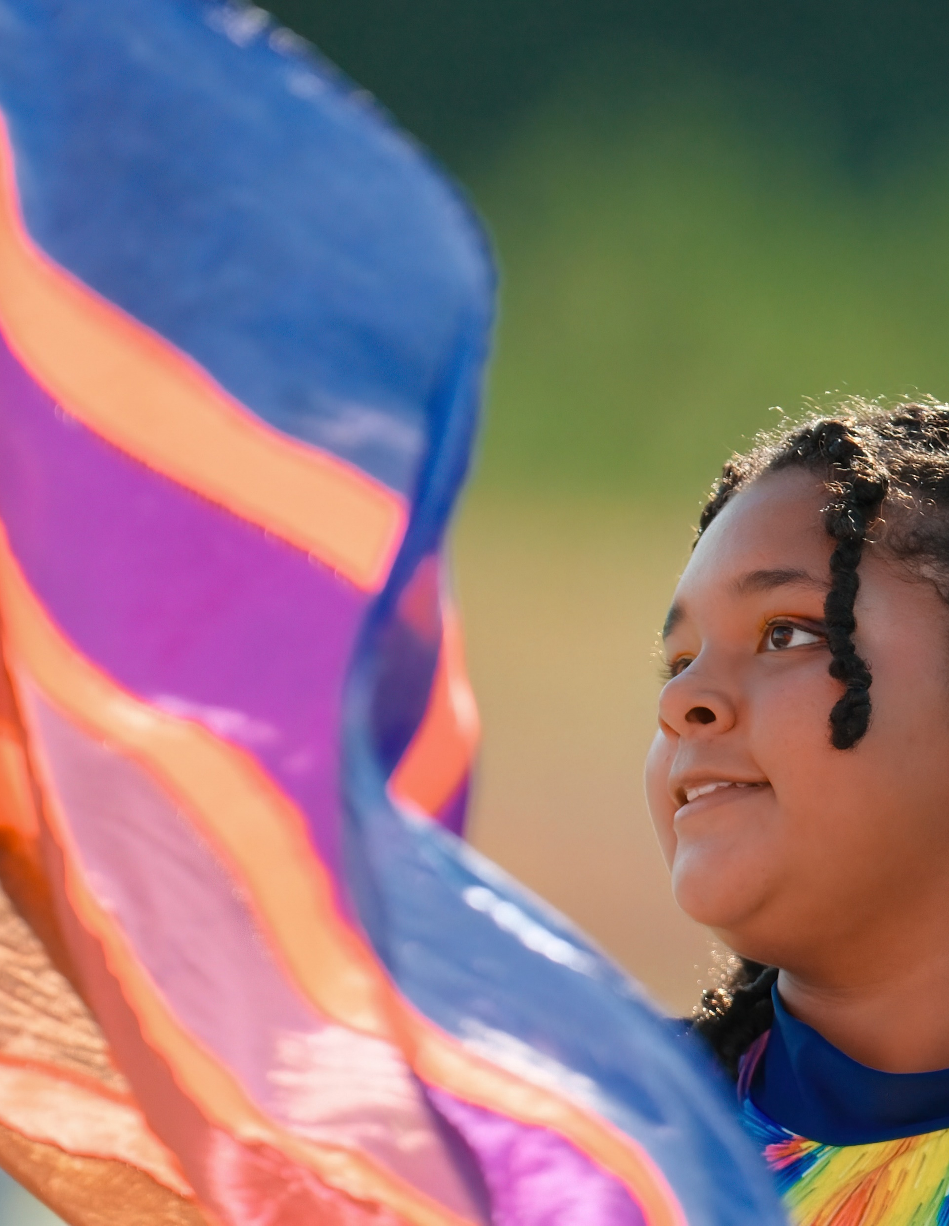
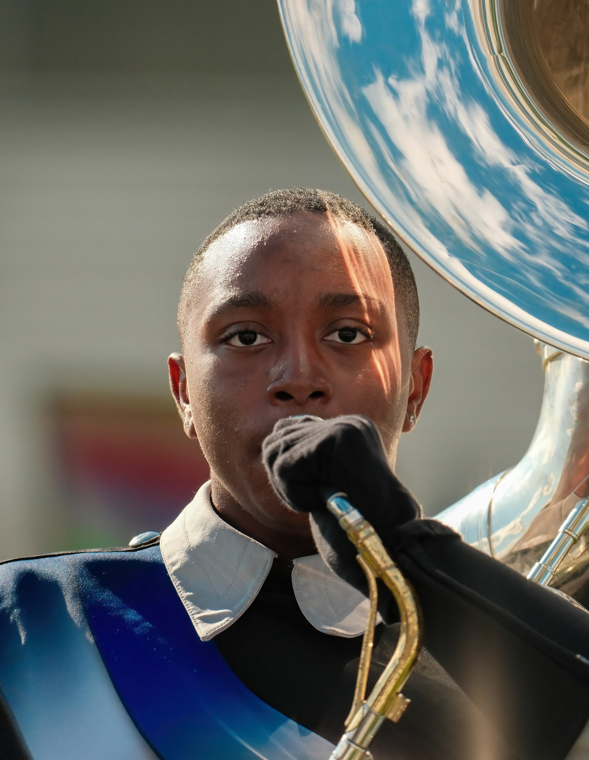
MARCHING BAND ACCOMPLISHMENTS

Slide 5
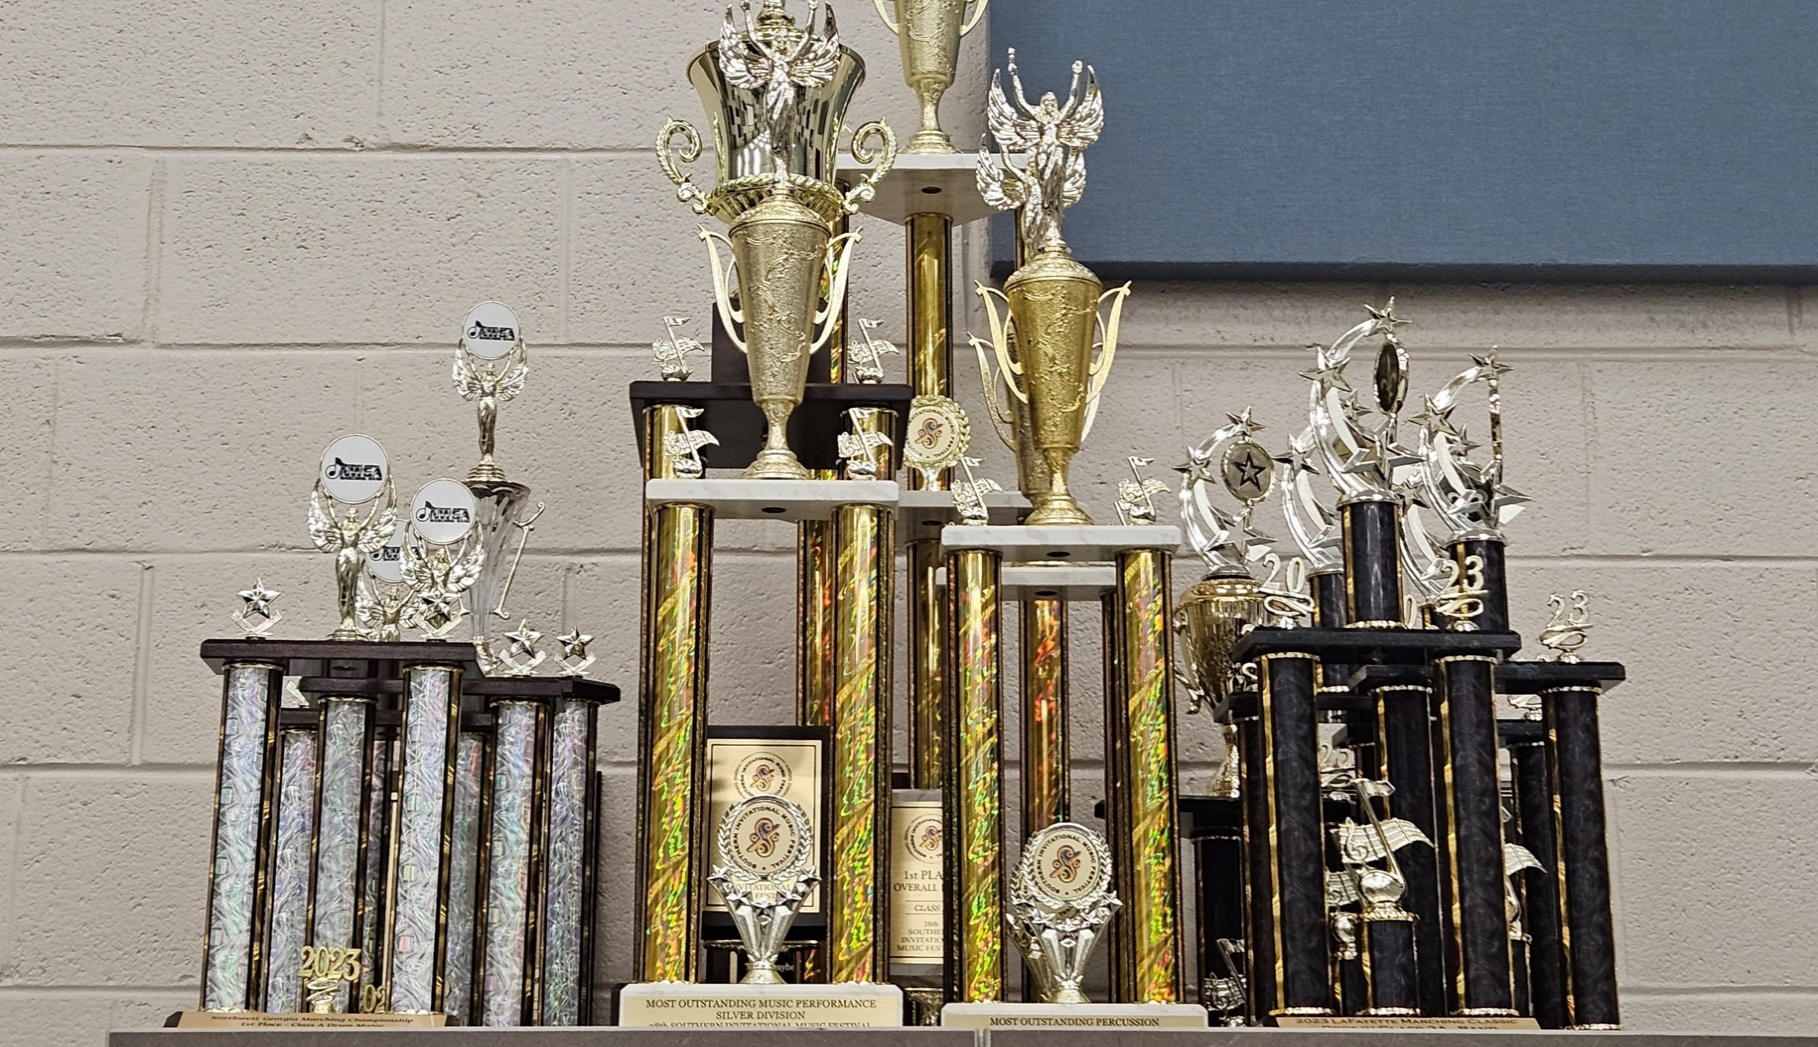
UNDEFEATED THREE YEARS IN A ROW!

Slide 6
Concert Band Accomplishments

Slide 7
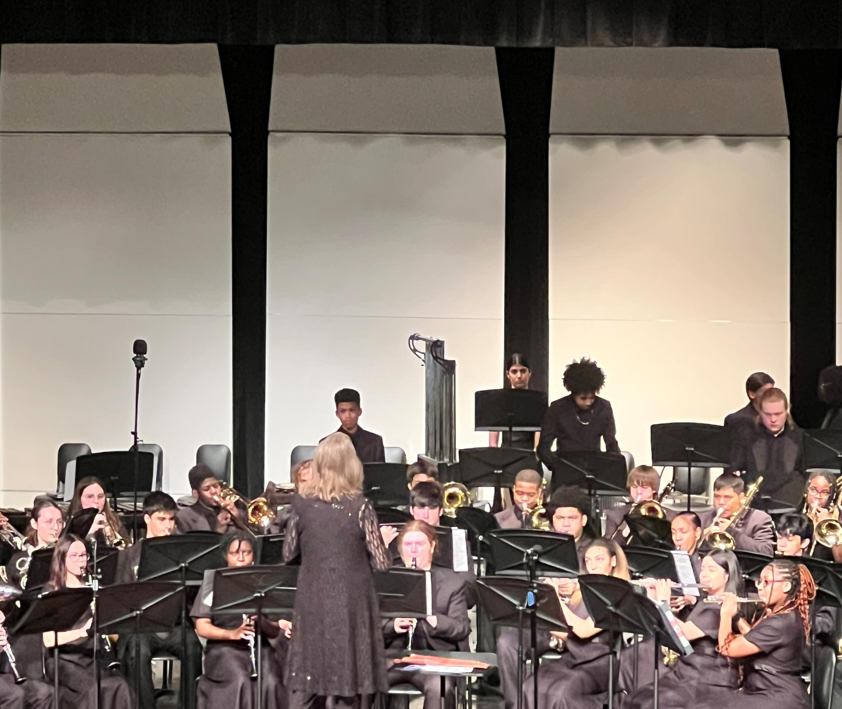
Symphonic Band – Superior Ratings for Stage Performance & Sight-Reading 3 years running!

Slide 8
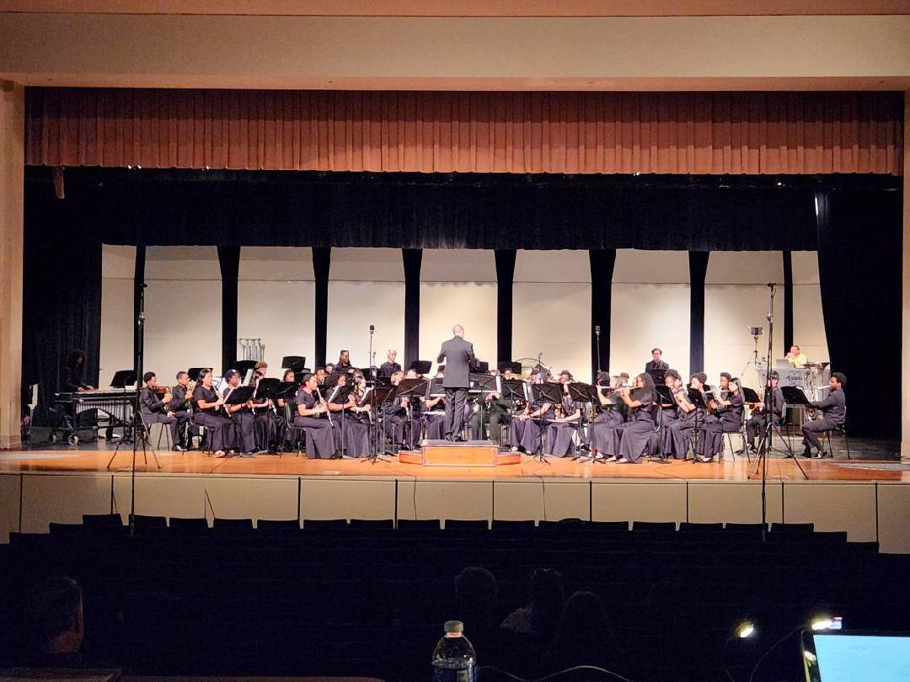
Spartan Band - Superior & Excellent Ratings at LGPE the last three years!

Slide 9
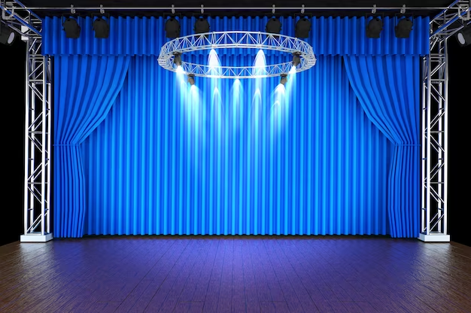
Concert Ensembles
Advanced Symphonic Band
Intermediate Concert Band
Beginning Spartan Band
Spring Ensembles
Jazz Band
Percussion Ensemble

Slide 10
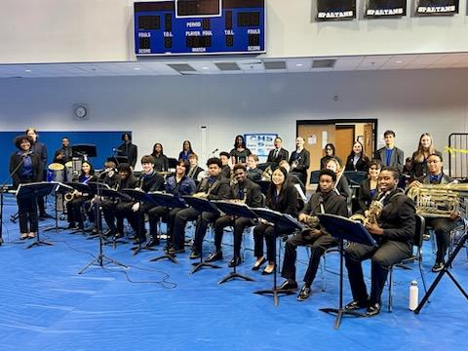
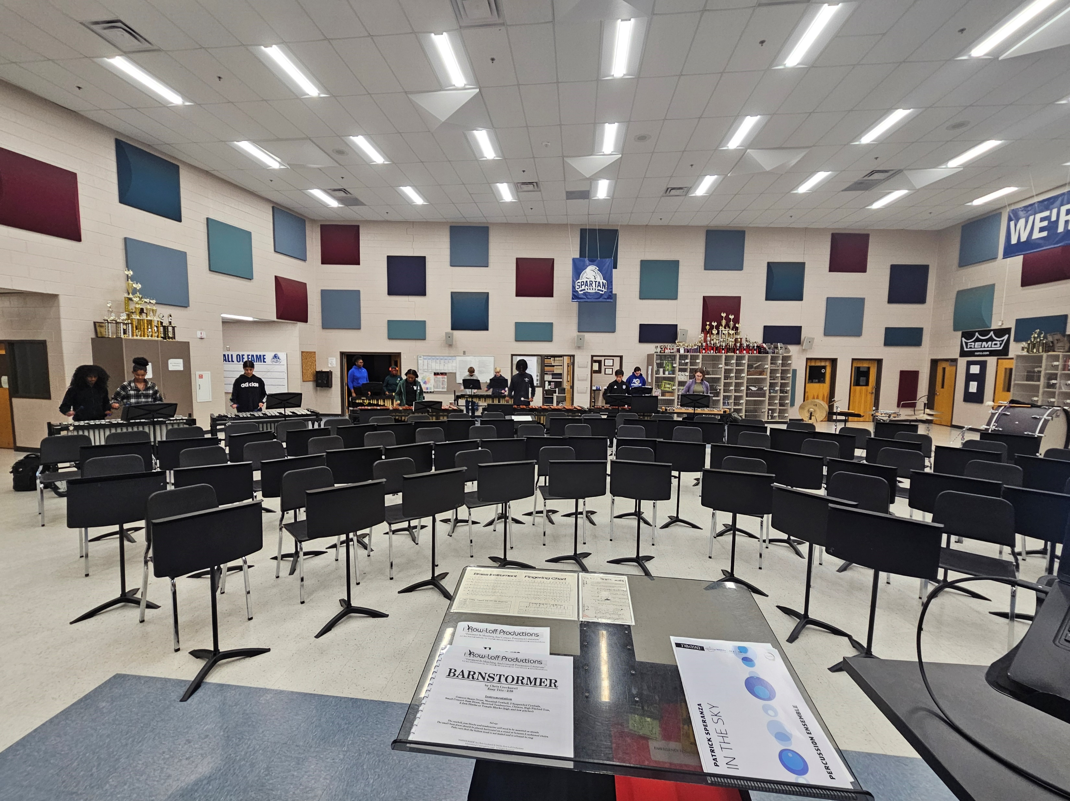
Spring Semester Ensembles
Jazz Band
Meets Tuesday & Thursday Afternoons
3:45 pm – 5:30 pm
Percussion Ensemble
Meets Tuesday & Thursday Mornings
7 am – 8 am

Slide 11
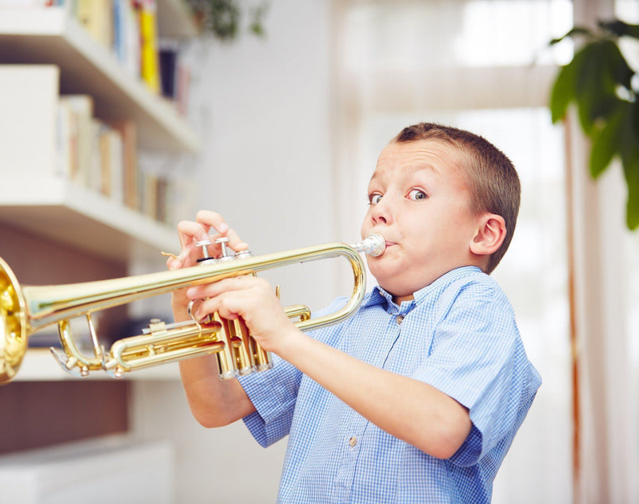
End-of-Semester Playing Finals
Playing finals information was given to the students the Monday after LGPE (March 18, 2024).
All students play the same excerpt to compare. This score will be used to place the students in ensembles for next fall.
Students have already been scheduled for a playing final time. Dates for the finals: Monday, 4/29/24 – Monday, 5/6/24. They will be in the newsletter this Sunday.
Written finals will be the last two days of school.

Slide 12
Upcoming Concerts
Chamber Ensembles, Percussion
Ensemble, & Jazz Band
Thursday, April 25, 2024
7 pm
CHS Performing Arts Center
$5 Suggested Donation
If you ordered a hanging basket, they will be available at the conclusion of the concert.
Concert Attire will be turned in after the concert.
Thursday, May 9, 2024
7 pm
CHS Performing Arts Center
Free Admission

Slide 13
CHS Annual Band Banquet
Friday, May 10, 2024
6:30 pm
Covenant United Methodist Church
Tickets are $10 per person.
More information will be in this weekend’s newsletter.

Slide 14
Paperwork/ Handbook

Slide 16
Dr. Mulcahy &
Mr. Smith

